Slide 1

GRADUATION PROJECT
DESIGNING A SELF-DRIVING CAR MODEL APPLYING IMAGE PROCESSING TECHNOLOGY

Slide 2
Chapter 00: Table of Contents
01
03
Introduction
Building The Algorithm
Introduction to the graduation project
Applying computer vision techniques
02
04
Building Car Model
Result and Conclusion
Building and choosing physical parts
Running the car model

Slide 3
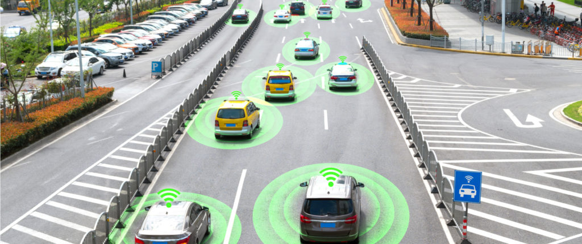
Chapter 01: Why did I choose this topic?

Slide 4
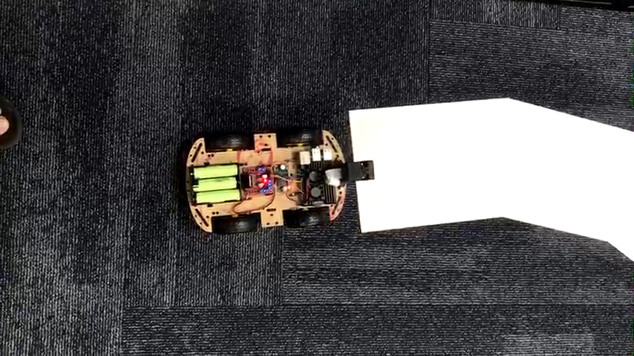
Chapter 01: Project Summary
Building a car model that can automatically run on the pre-defined road
Using white A4 paper as the road and placing it on a darker ground
Object detection and precise motor control (PID) are not of interest

Slide 5
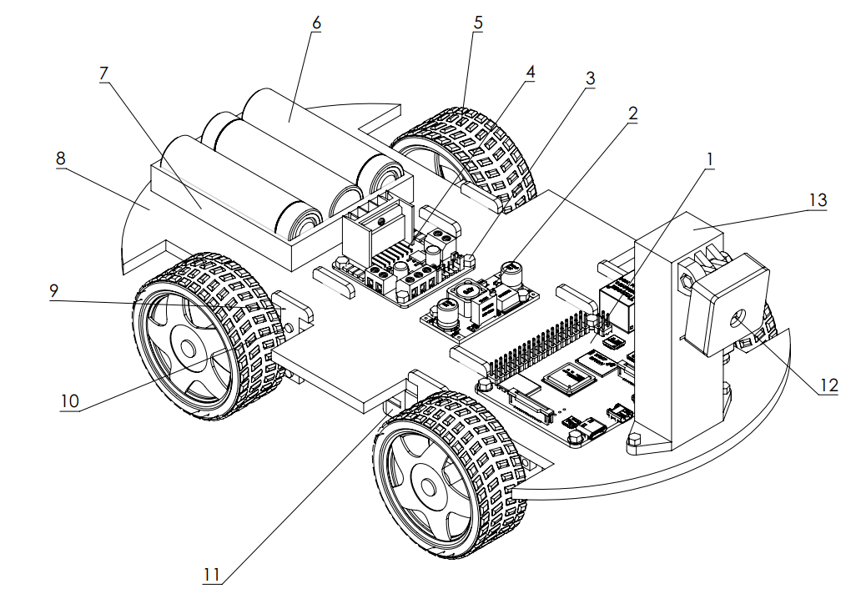
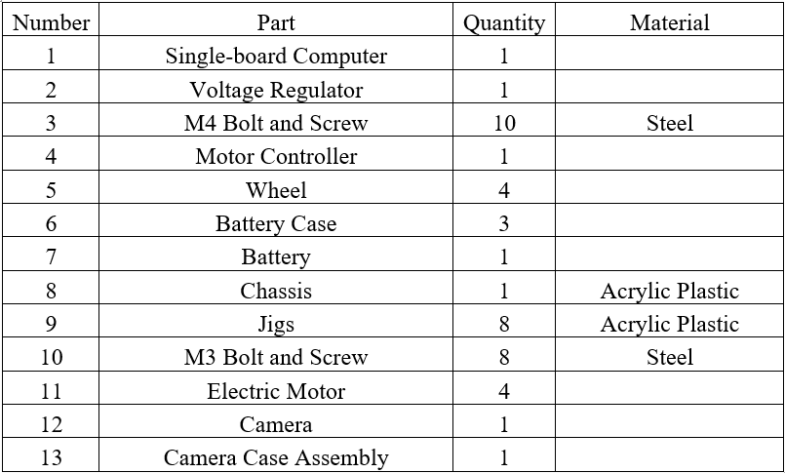
Chapter 02: Physical Design of The Car Model

Slide 6
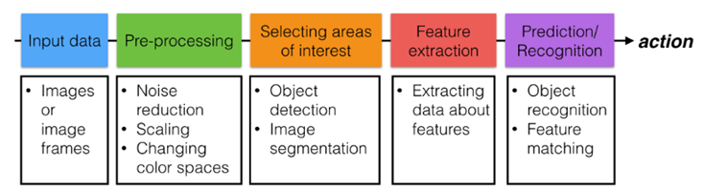
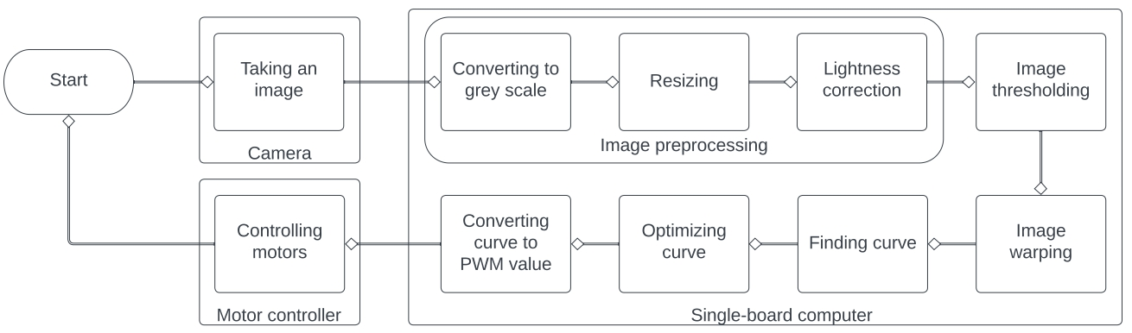
Chapter 03: Computer Vision Pipeline
General Computer Vision Pipeline
Applying Computer Vision to Build Lane Detection Algorithm

Slide 7
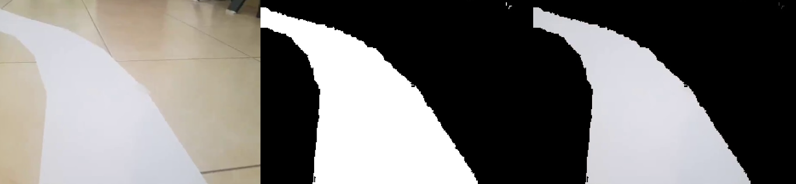
Chapter 03: Image Thresholding
Isolate the road with other objects
Create a threshold for the value of brightness
Pixels that have lower brightness value will be turn into black, the other pixels are kept unchanged

Slide 8
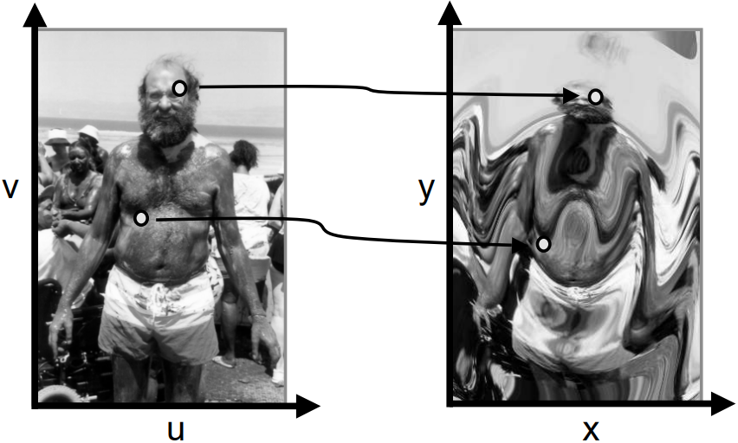
Chapter 03: Image Warping
Map the location of every pixels of original image with a function to create a new distorted version of the image

Slide 9

Chapter 03: Image Warping
Change the perspective of the image for easier processing

Slide 10
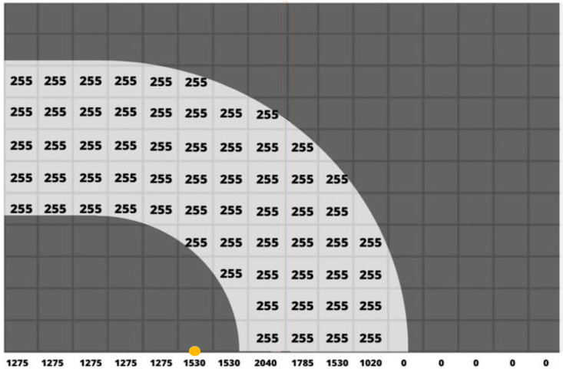
Chapter 03: Finding Curve
y
Sum pixels in y direction to find bright region
A region is consider bright if its brightness value larger than a pre-defined threshold
Find the middle point A of bright region
O
0
1
2
3
4
5
6
7
8
9
10
11 12 13 14 15
x
Bright region
Dark region
Point A position = 5

Slide 11
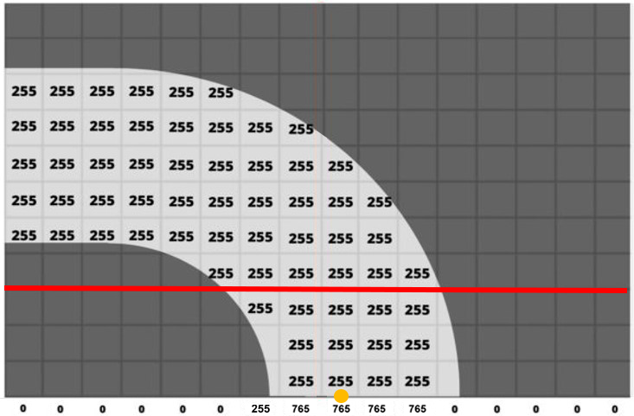
Chapter 03: Finding Curve
y
Consider the front near region
Do similarly to find point B
Subtract A and B to get the lane curve
In this example: A – B = 5 – 8 = -3
Negativity: turn left
Value: how much the car should turn left
O
1
2
3
4
5
6
7
8
9
10
0
11 12 13 14 15
x
Dark region
Bright region
Dark region
Point B position = 8

Slide 12
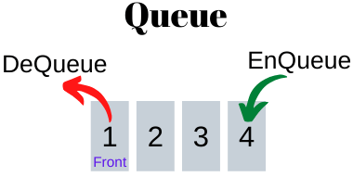
Chapter 03: Optimizing Curve
Curve values are closely related
Use queue and output the average of all values in the queue
This allows smooth motion and avoid any dramatic movements
Time T
Time T + 1
Time T: Curve = (1 + 2 + 3)/3 = 2
Time T + 1: Curve = (2 + 3 + 4)/3 = 3

Slide 13
Chapter 03: Control System
Two right motors are connected in parallel; Same with two left motors
The car model runs at normal speed
Turn left/right:
Left/right motors: normal speed
Right/left motors: value calculated by the formula
PWM: output voltage value for controlling the motor (V)
input_curve: detected lane curve (%)
sensitivity: how sensitive the car with lane curve
normal_speed: voltage value of the motor when the car model detects no lane curve (V)

Slide 14
Chapter 04: Combining Everything and Running the Car Model

Slide 15
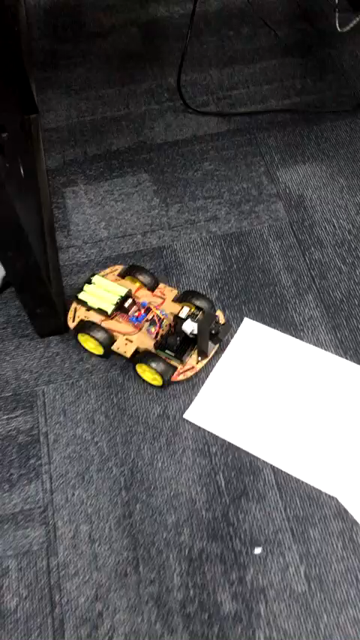
Chapter 04: Combining Everything and Running the Car Model

Slide 16
Chapter 04: Conclusion
Explore computer vision theory and applications
Choose electrical and design physical parts to make a car model
Apply computer vision to create a lane detection algorithm
Assemble and successfully run the car model with the algorithm

Slide 17
THANK YOU !

Slide 18
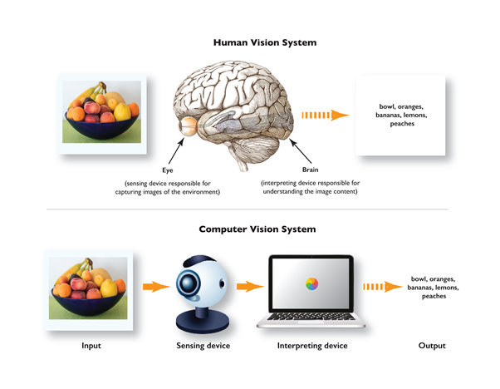
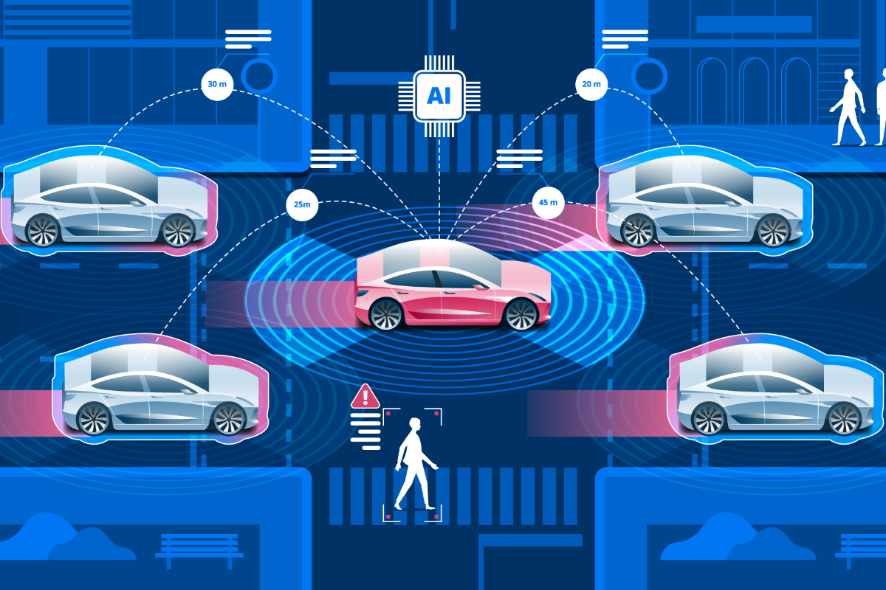
Archived: Introduction to Autonomous Driving and Computer Vision
Computer Vision
Autonomous Driving
Allowing computers to obtain meaningful data from visual inputs such as photos and videos
Vehicle capability of sensing its surrounding and operating without human involvement

Slide 19
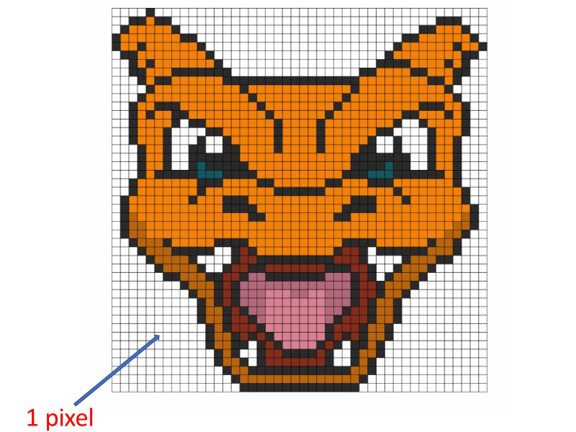
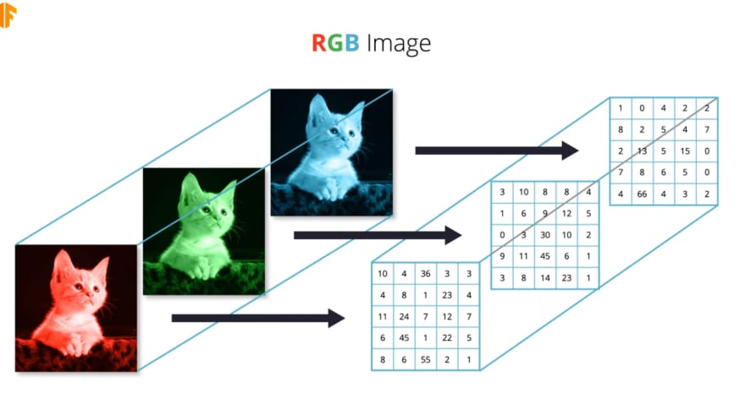
Archived: Formations of Digital Images
Digital image are constructed by many small pixels
Each pixel contains numerical values representing intensities of colors in a particular location
In RGB image is a stack of three 2D matrices of pixels.
Pixel value ranges from 0 (black) to 1 (absolute red/green/blue)

Slide 20
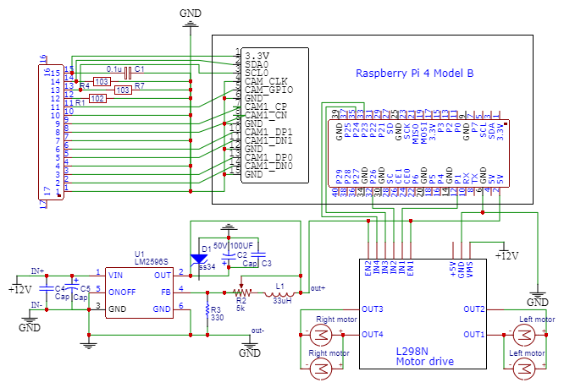
Archived: Schematic of The Car Model

Slide 21
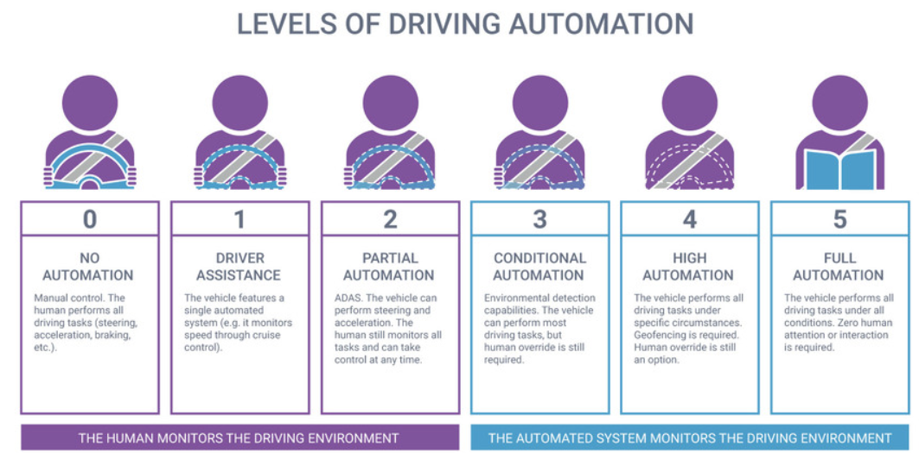
Archived: Six Levels of Automation

